Slide 1
Online Driver Hiring
Presented by
Naimul Islam (21201142)
Maruf Ahamed (21201144)

Slide 2

Motivation
With the increasing demand for convenient and safe transportation, we aimed to develop a system that connects users with reliable drivers, making hiring and ride booking easier and more secure.

Slide 3
Problem Defination
Existing ride-booking systems often lack transparency in driver verification, flexibility in ride scheduling, and structured job opportunities for drivers. Our goal was to build a platform that solves these issues holistically.

Slide 4
Objective, Solution & Project Output
Objective
Solution
Project Output
To build a user-friendly web platform where users can book rides, drivers can register and get approved, and admins can manage the ecosystem.
An integrated MERN stack application with role-based access for User, Driver, and Admin.
Functional modules for booking, payment, verification, and job posting with real-time data flow and secure login.

Slide 5

Impect on Socity
Our platform empowers local drivers with job opportunities, enhances user safety through verification, and promotes cashless, planned transportation for daily commuters.

Slide 6
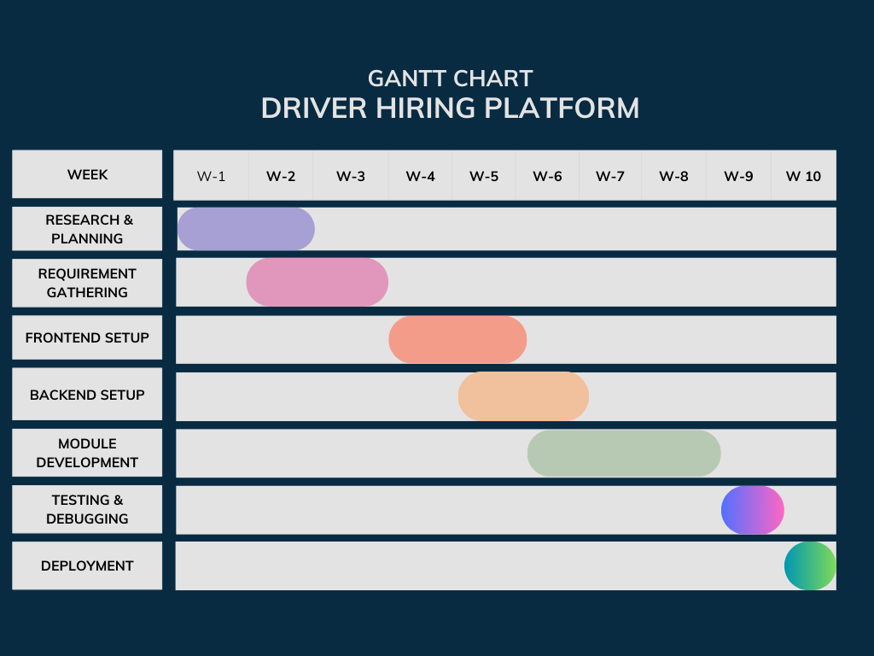
Time Table

Slide 7
Cost Analysis
One -Time Cost
Domain Purchase | $10 – $15/year
UI/UX Design | $0 – $12
Development Tools | $0-15
Initial Hosting Setup | $5 – $20
SSL Certification | $0
Total One-Time Cost: ~$15 – $47

Slide 8
Cost Analysis
Operational Costs (Monthly/Annually)
Hosting | $5 – $10/month
Database Backup & Monitoring | $0 – $5/month
Domain Renewal | ~$10/year
SMS/Email Services | $0 – $10/month based on usage
Maintenance & Updates | N/A (time-based)
Estimated Monthly Operational Cost: ~$5 – $25
Estimated Annual Operational Cost: ~$60 – $300

Slide 9
Break-Even Analysis
Monthly Revenue at 200 rides:
200 rides × $5 = $1,000 total ride value
Platform earns 10% of $1,000 = $100
Monthly Costs:
Operational = $20
Net Profit per Month:
$100 (revenue) − $20 (cost) = $80
Break-Even Point:
Initial investment = $40
Monthly profit = $80
Break-even time = $40 ÷ $80 = 0.5 months

Slide 10

CEP Mapping (K’s)
K’s | Attributes | How K’s are Addressed Through the Project
K1 | Engineering Knowledge | Applied software engineering principles, tools, and frameworks (Node.js, React, MongoDB) to build the system.
K2 | Problem Analysis | Identified real-world problems in ride booking and driver hiring and defined technical solutions.
K3 | Design/Development of Solutions | Designed scalable architecture, modular backend, responsive UI, and built secure APIs.
K4 | Investigations | Collected user needs, analyzed similar platforms (Uber, Pathao), and evaluated features.
K5 | Modern Tool Usage | Used modern development tools (VS Code, Git, Postman, MongoDB Compass) and libraries.
K6 | The Engineer and Society | Contributed to societal impact by providing easier access to transport and driver hiring.
K7 | Environment and Sustainability | Promoted efficient route management and digital recordkeeping to reduce paper use.

Slide 11
CEP Mapping (P’s)
P’s | Attributes | How P’s are Addressed Through the Project
P1 | Engineering Tools | Used Git, GitHub, VS Code, MongoDB Compass, Postman, and deployment platforms like Vercel/Render.
P2 | Communication | Documented all modules, wrote clean code with comments, and prepared a final project report and presentation.
P3 | Individual and Team Work | Collaborated as a team to divide tasks (frontend, backend, testing) and conducted weekly reviews.
P4 | Ethics | Ensured data privacy, secure login, role-based access (admin/moderator), and ethical handling of user data.
P5 | Project Management | Followed a 10-week structured timeline from planning to deployment with progress tracking.
P7 | Innovation & Entrepreneurship | Developed a real-world marketable solution for urban ride booking and driver hiring, exploring potential monetization strategies.

Slide 12
CEP Mapping (A’s)
A’s | Attributes | How A’s are Addressed Through the Project
A1 | Discipline | Followed deadlines in the 10-week plan and maintained version control practices with Git.
A4 | Team Spirit | Collaborated effectively, respected peer input, and held regular meetings for team coordination.

Slide 13
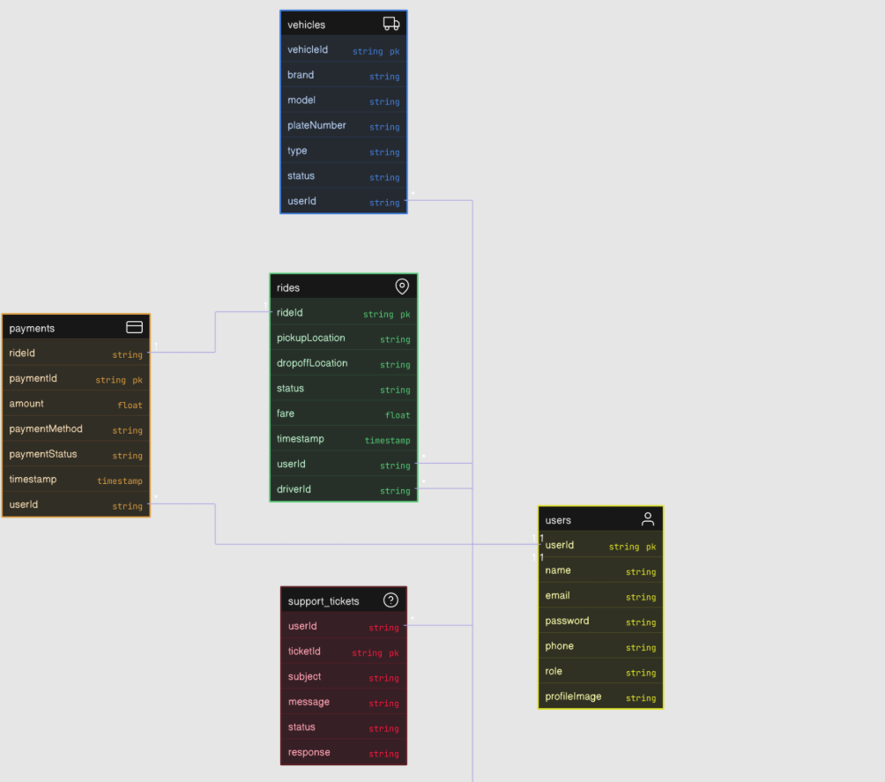
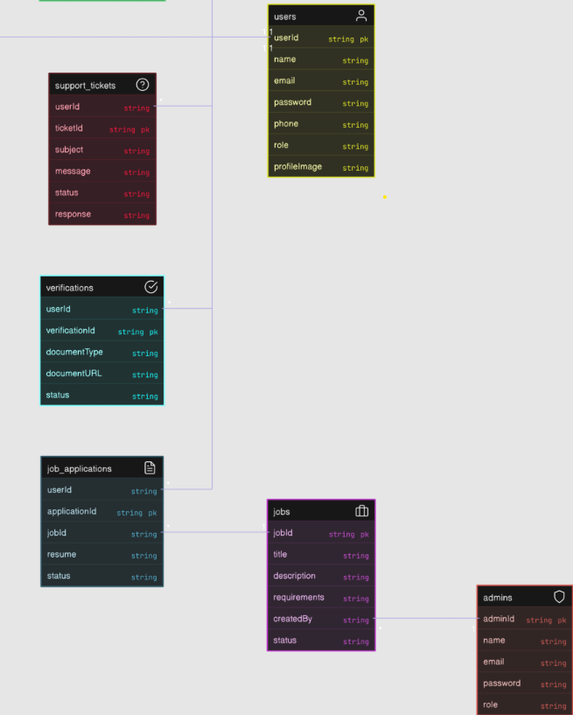
ER Diagram

Slide 14
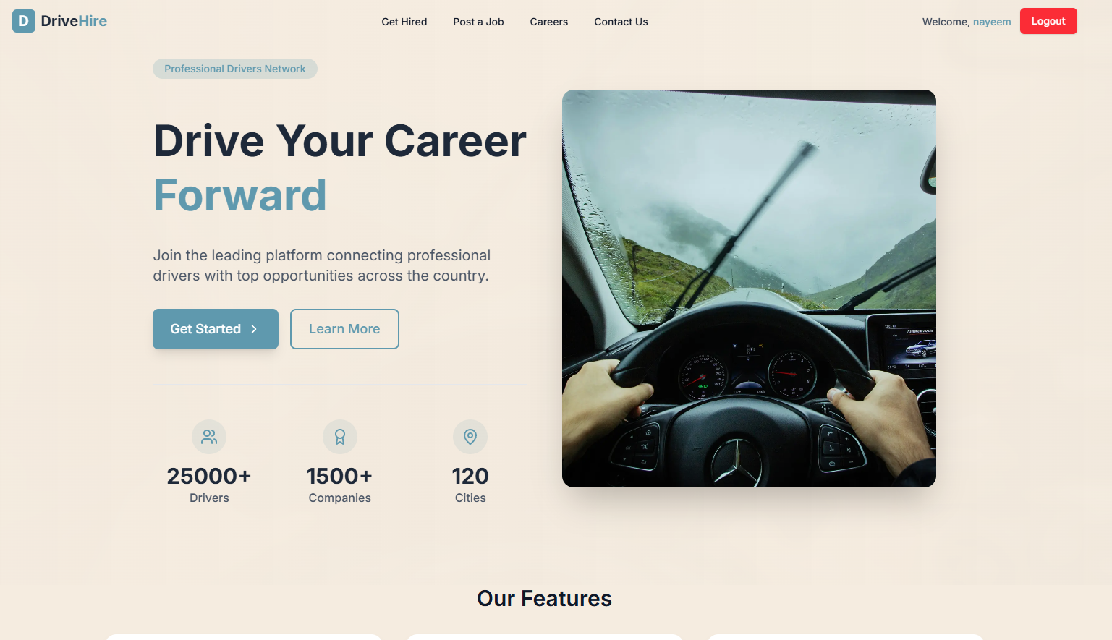

Slide 15
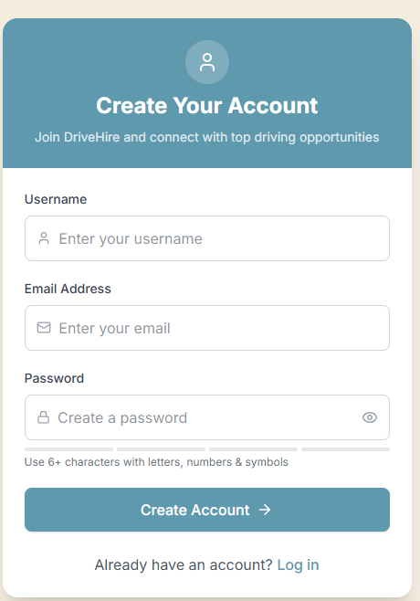
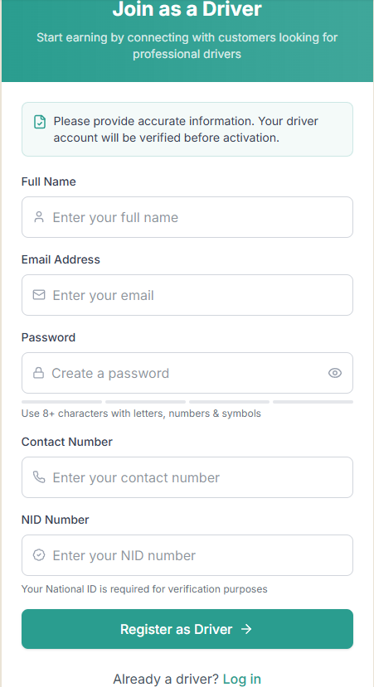

Slide 16
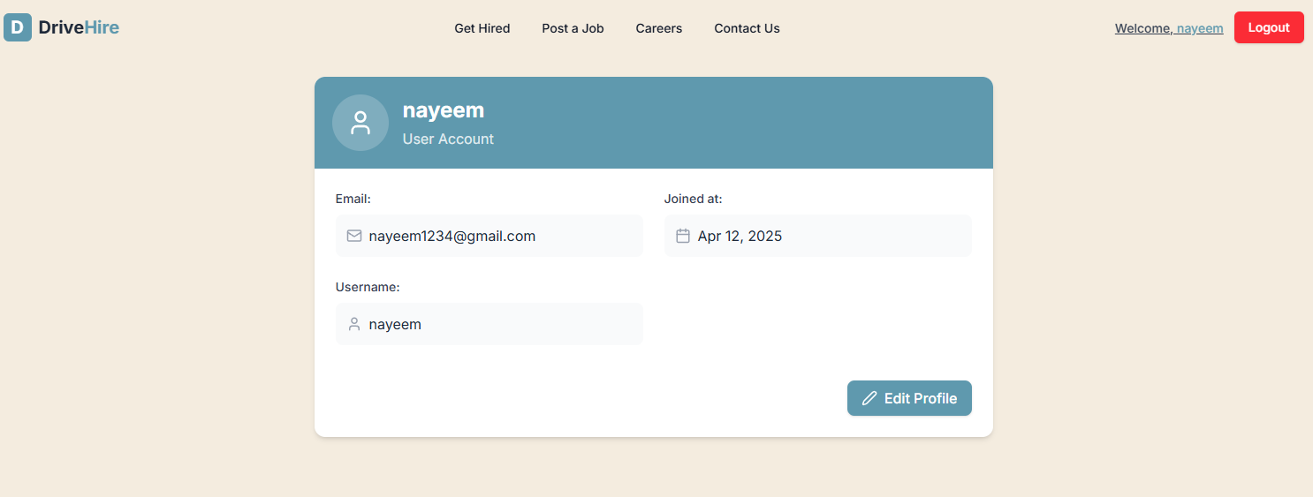

Slide 17
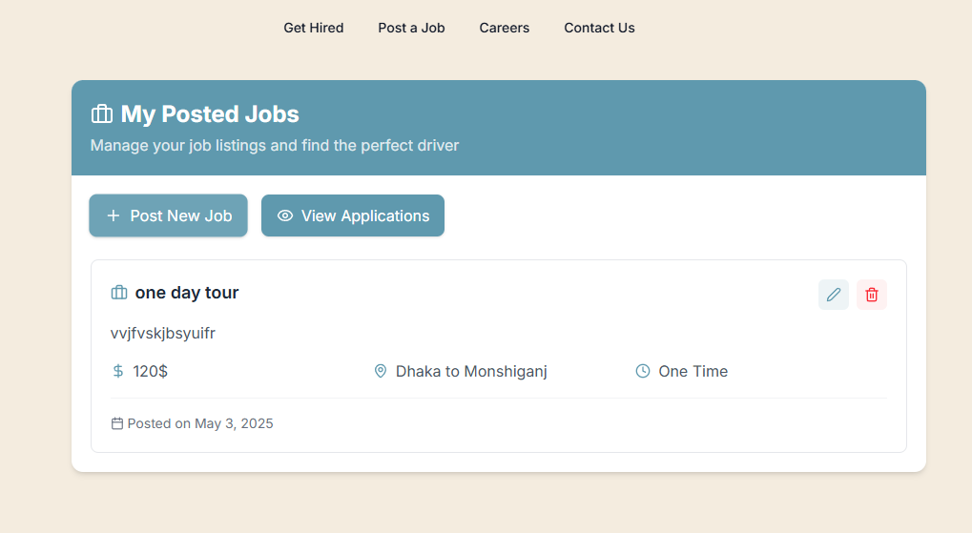

Slide 18
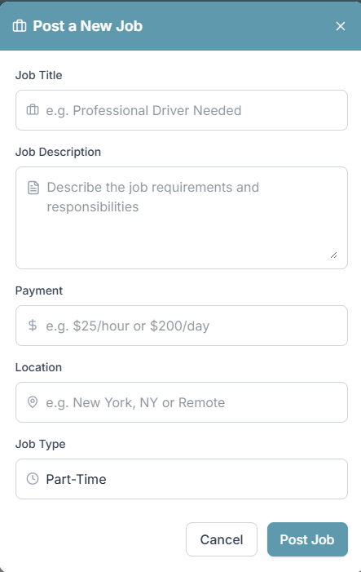
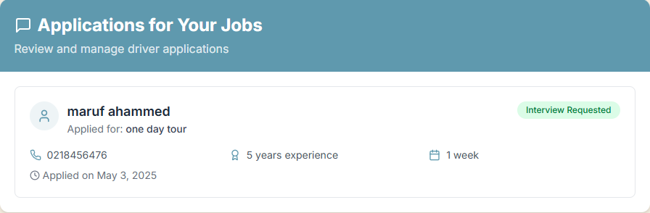

Slide 19
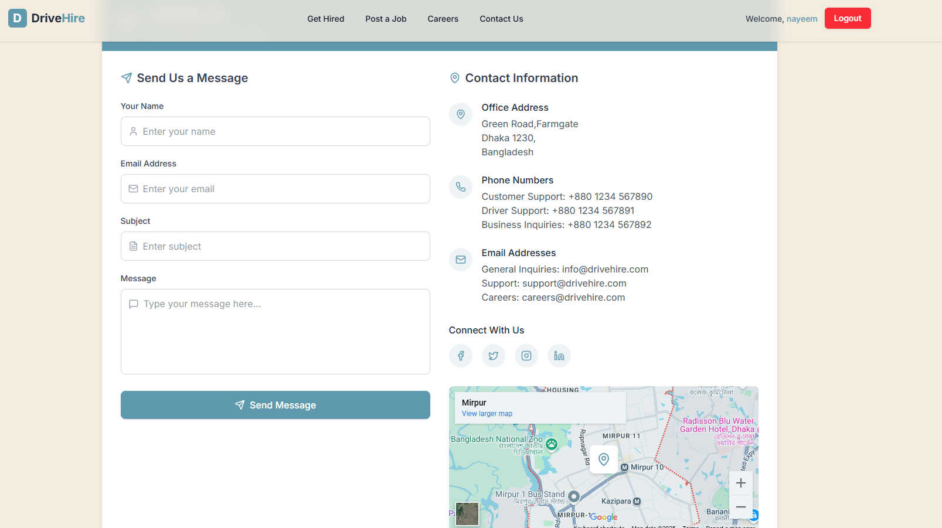

Slide 20
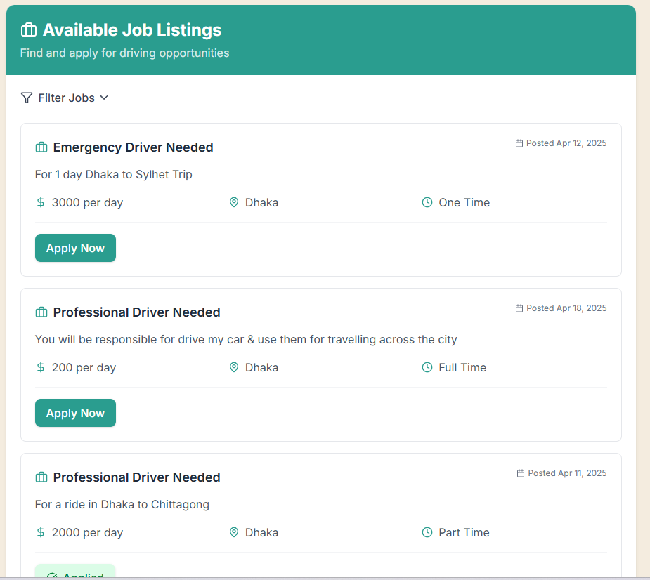

Slide 21
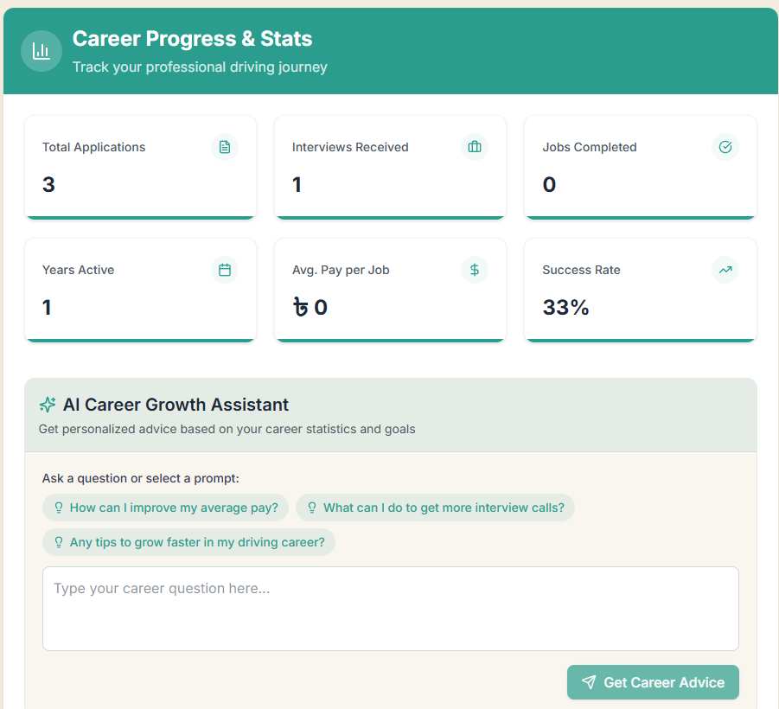

Slide 22
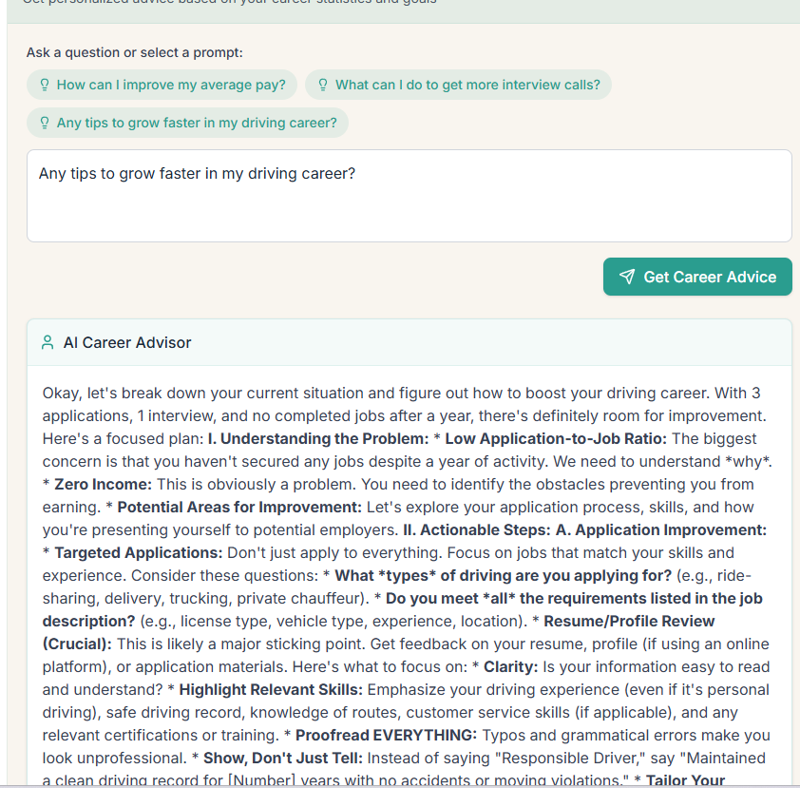

Slide 23
Git Link: https://github.com/Naimul2580/Driver_Hiring Vercel Link: https://driverhire.vercel.app/

Slide 24
Thank You

